Slide 1
EE 277 Project Presentation May 13, 2021 Zoom Online
Group #02
Gaurav Deore
Nikhil Bellad
Keyur Doshi

Slide 2
Project
Low Power Parallel to Serial Interface Using Asynchronous FIFO

Slide 3
Outline:
Overview
Design Methodology
Gray code pointer style #1
Binary code pointer style
Gray code pointer style #2
Design challenges & Learning outcome
Conclusion

Slide 4
Overview:
Design and simulate a low power parallel to serial interface operating in two different clock domains capable of taking in parallel data converting it to serial data and transmitting it serially at the output appending start and end delimiters to the packet.

Slide 5
Design methodology:
Async FIFO (Gray code pointer style #1)
Parallel Interface
Serial Interface

Slide 6
Design methodology:
Async FIFO (Binary code pointer style)
Parallel Interface
Serial Interface

Slide 7
Design methodology:
Async FIFO (Gray code pointer style #2)
Parallel Interface
Serial Interface

Slide 8
Parallel interface:
Test Bench
Parallel Interface
P_clk
n_rst
serial_data_out
req
grant
write_en
parallel_data_in

Slide 9
Parallel interface:
Parallel Interface is designed using FSM
It operates on two inputs request and grant
When the request and grant are high, the FSM moves to the input state where parallel interface starts getting the 32-bit data from the test bench.
After getting 32-bit input, FSM moves on to the output state where FSM send the 32-bit data serially to FIFO using counter and shift operation.
Once the 32 bits are completed FSM returns back to IDLE state.
Idle State
Rst = 0
Req = 0
Grant = 0
Input State
Rst = 1
Req = 1
Grant = 1
Output State
Sending 32-bit data to FIFO serially

Slide 10
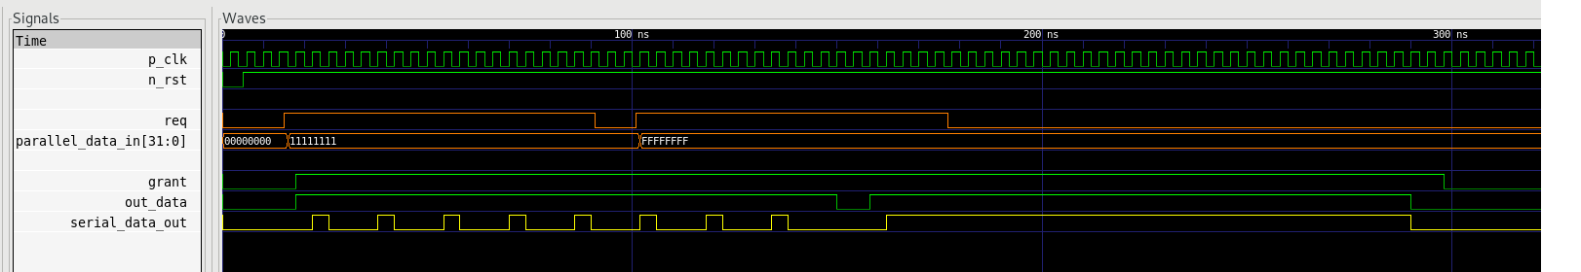
Parallel interface simulation results:

Slide 11
Design methodology:
Async FIFO (Gray code pointer style #1)
Parallel Interface
Serial Interface

Slide 12
Asynchronous FIFO:
Asynchronous FIFO’s are used in Clock Domain Crossing scenarios where the write clock is different from the read clock.
In this Parallel to Serial Interface, since the Parallel Interface and the Serial Interface work on different clocks, this FIFO is used to buffer the data .
Async FIFO (Gray code pointer style #1)
data_in
insert
dataOut
clk_in
full
rst
flush
empty
clk_out
remove

Slide 13
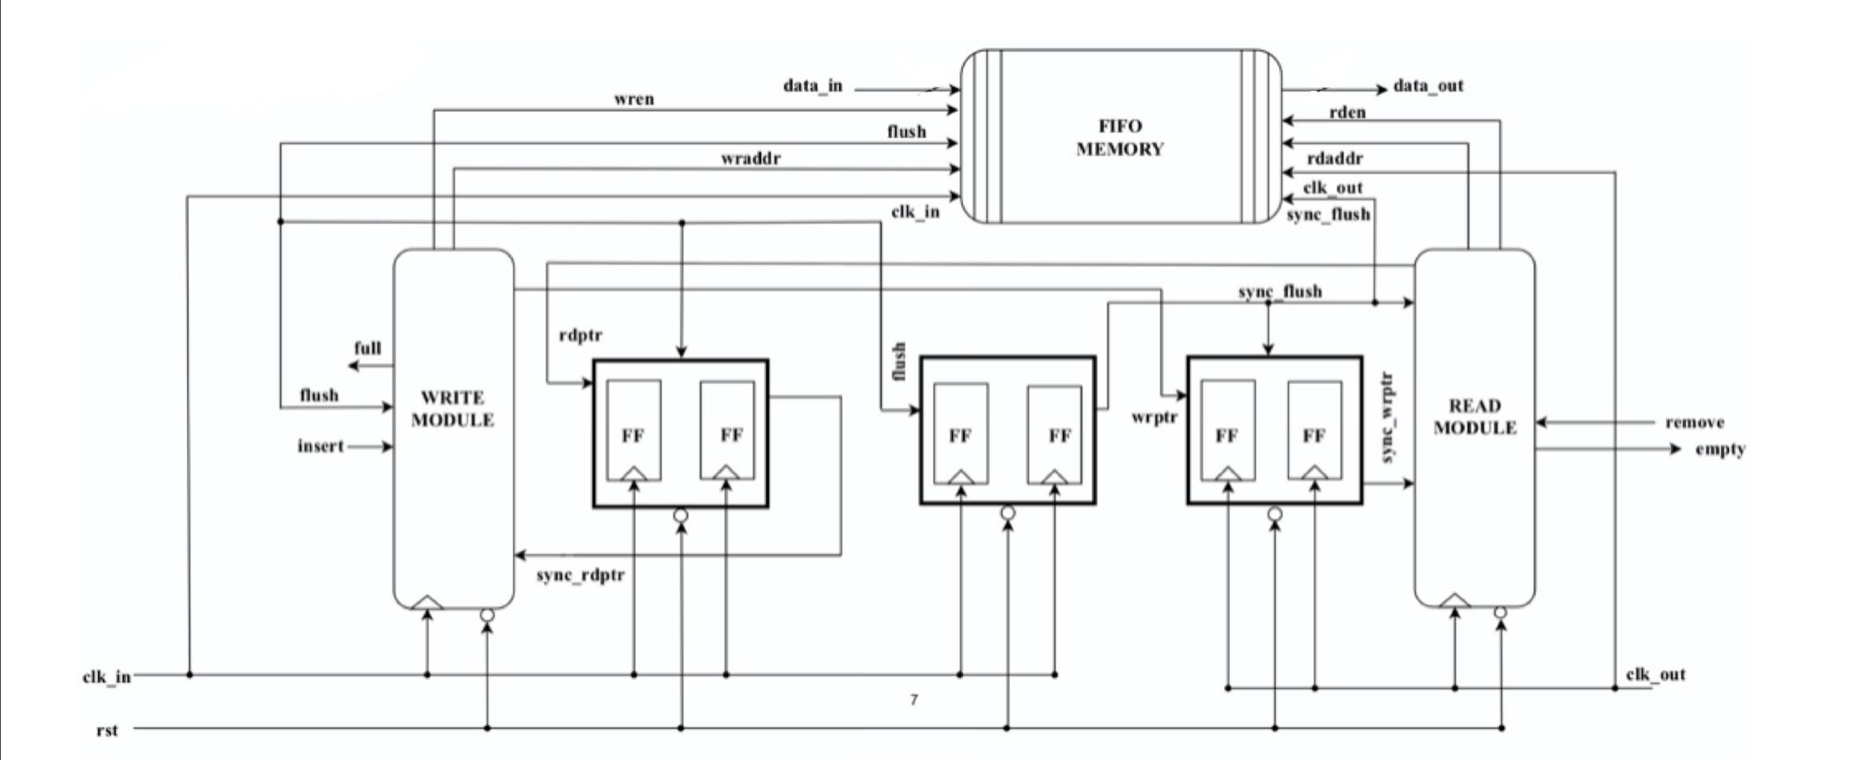
FIFO Block Diagram:

Slide 14
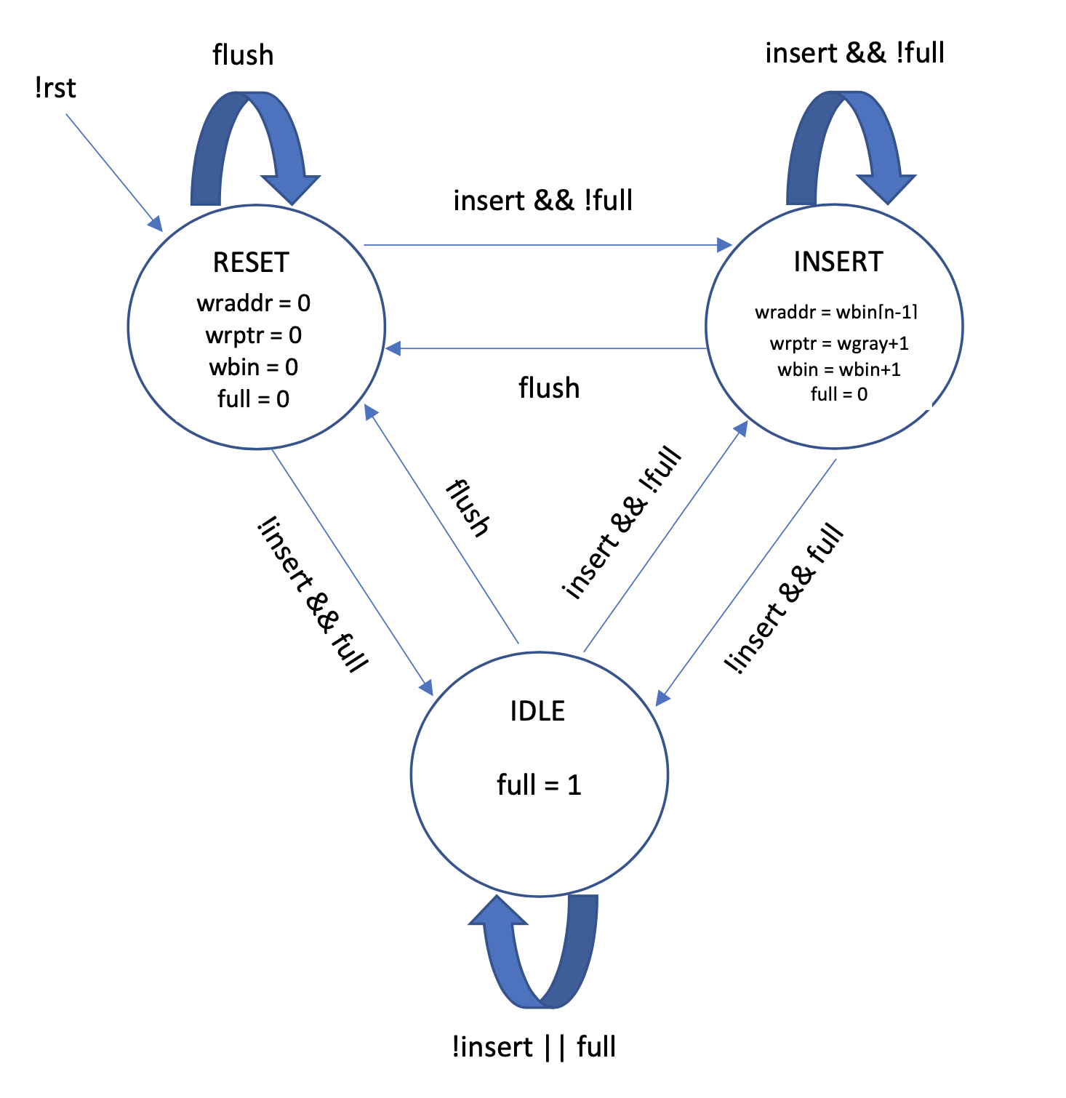
WRITE Module:
This FSM is used to write the data into the FIFO.
This block works on the parallel data clock.
The Insert signal is asserted to write the data.
This FSM checks for the full condition and writes data only when empty.

Slide 15
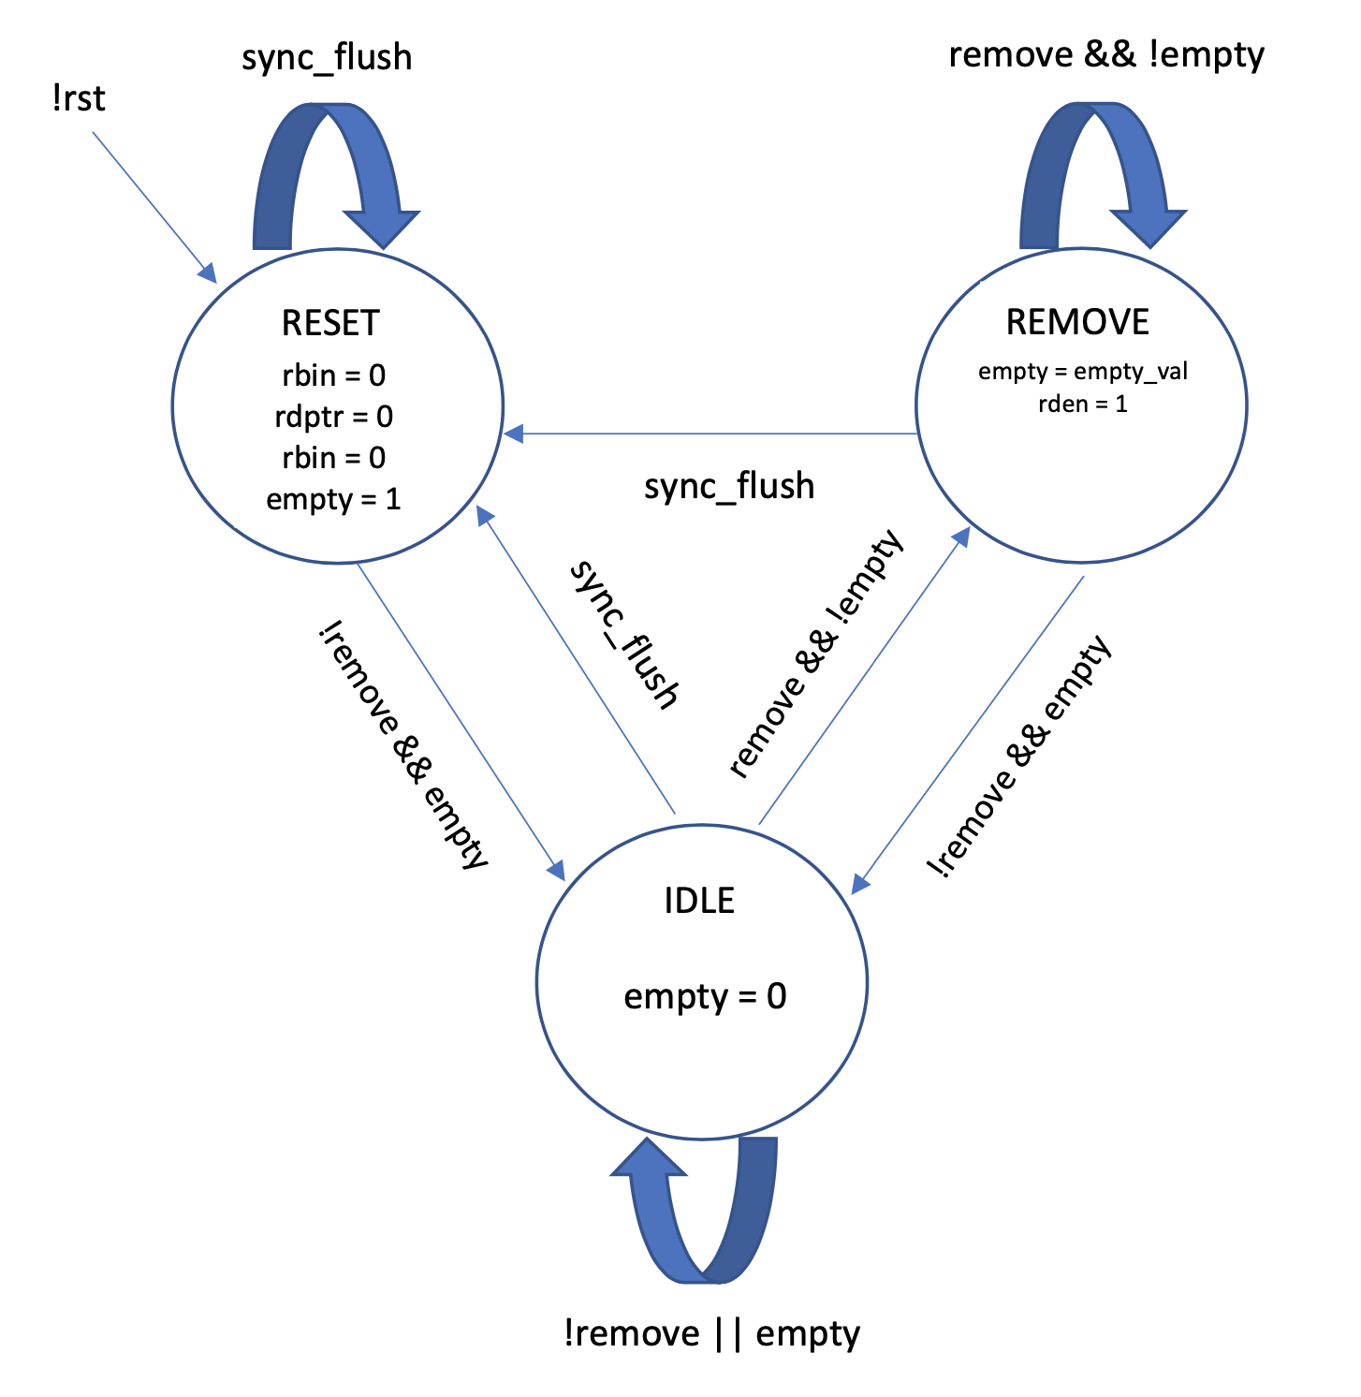
Read Module:
This FSM is used to read the data from the FIFO.
This block works on the serial data clock.
The remove signal is asserted to read the data.
The FSM checks on the empty flag before it reads the data.

Slide 16
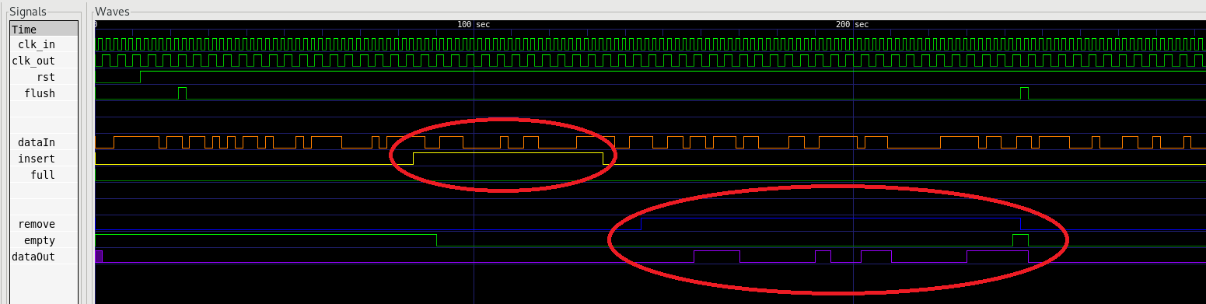
Async fifo simulation results:

Slide 17
Design methodology:
Async FIFO (Gray code pointer style #1)
Parallel Interface
Serial Interface

Slide 18
serial interface:
Reads data from the FIFO and outputs the serial data.
Handles the appending of delimiters.
Serial Interface
data_in
req
pop
output_psi
rst_n
s_clk

Slide 19
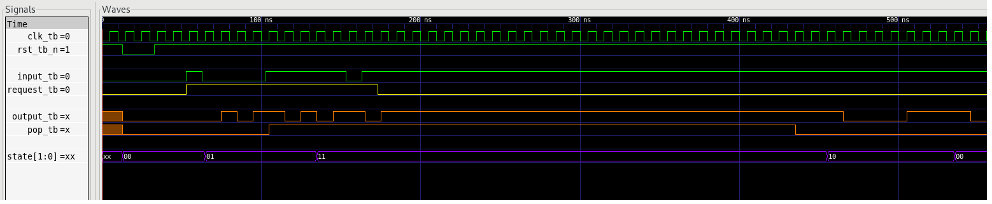
Serial interface simulation results:

Slide 20
Putting all together:
SOD
DATA
EOD

Slide 21
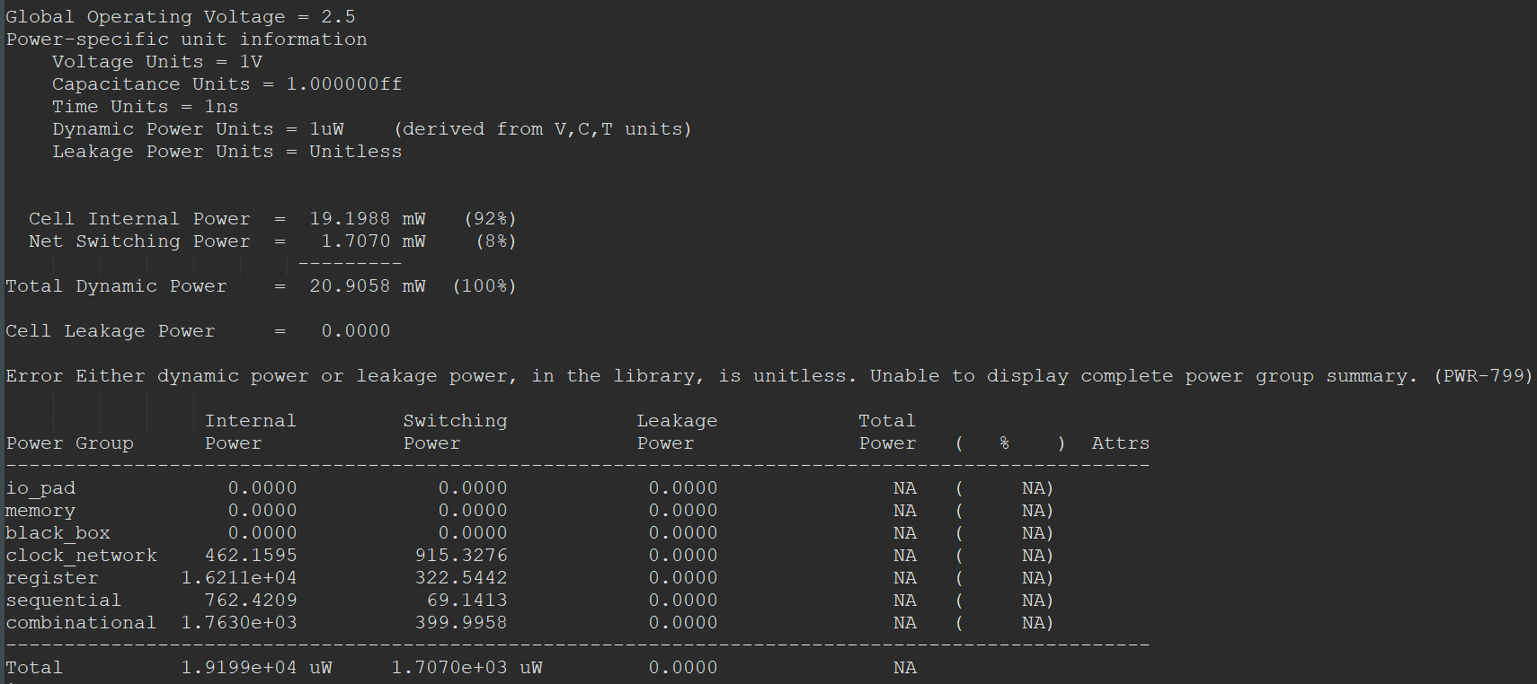
Synthesis Results:

Slide 22
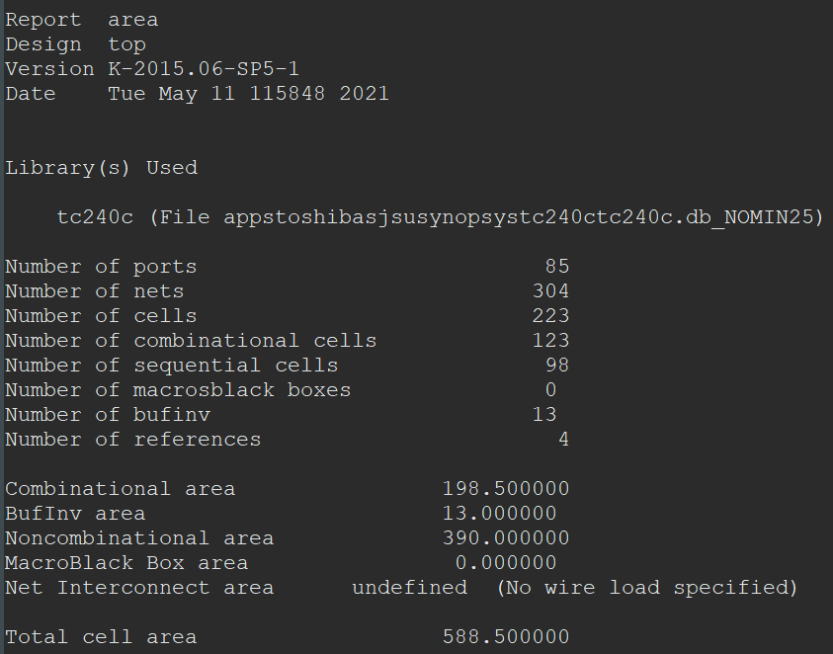
Synthesis Results:

Slide 23
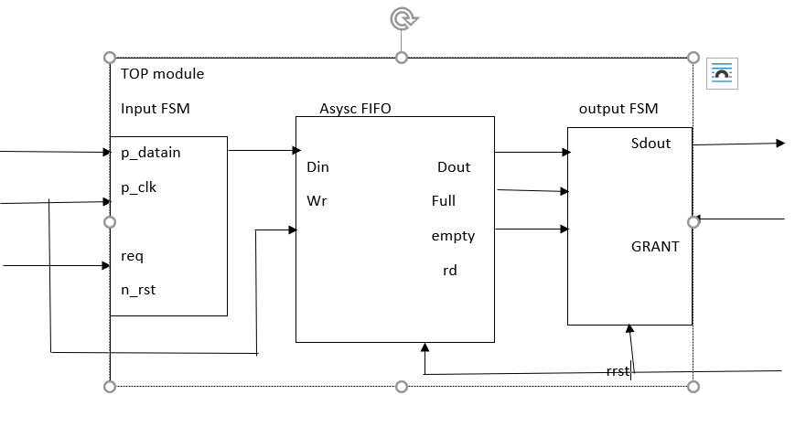
DESIGN Parallel IN and Seral out
Design Module PSI
Consist of Input state machine
asynchronous Fifo
Output state machine

Slide 24
Design Modules
INput MODULE
COUNTER to count number of bits shifted to Fifo
Shift register
FSM
ASYSC FIFO
Dual port Memory module
Input p_clk and s_clk
OUTPut FSM
FSM

Slide 25
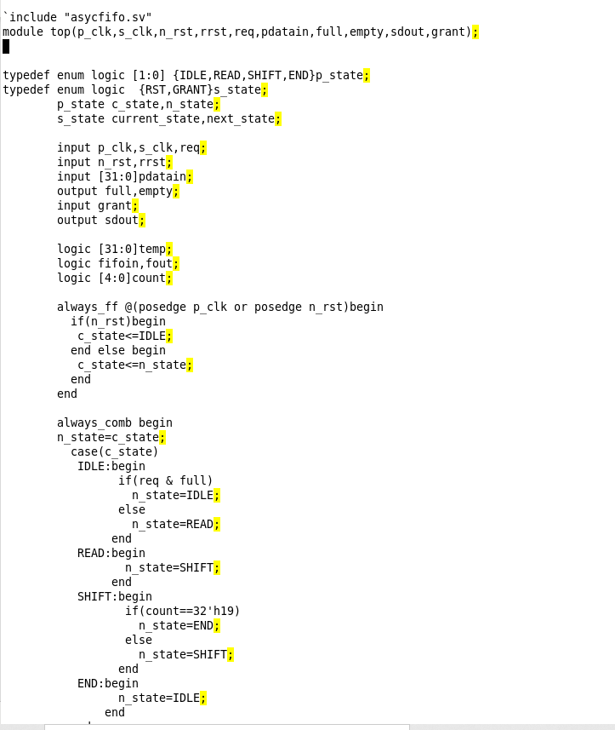
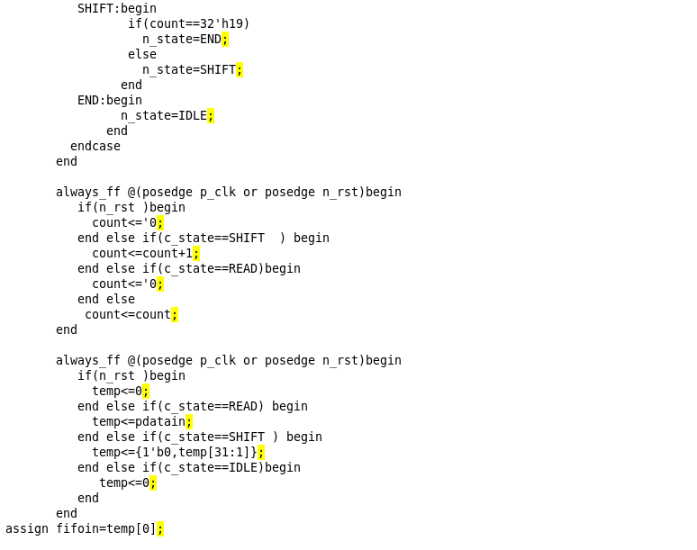
Input State machine

Slide 26
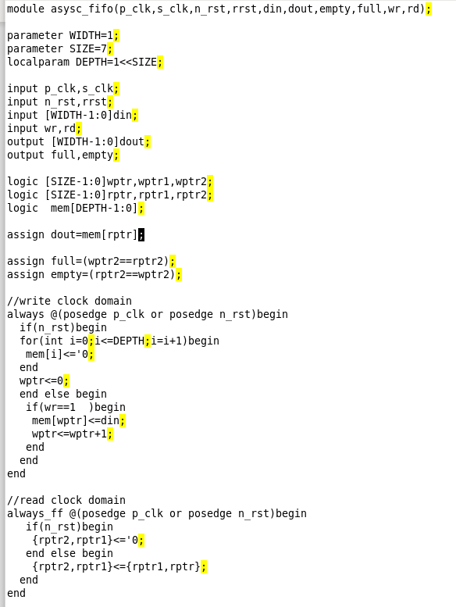
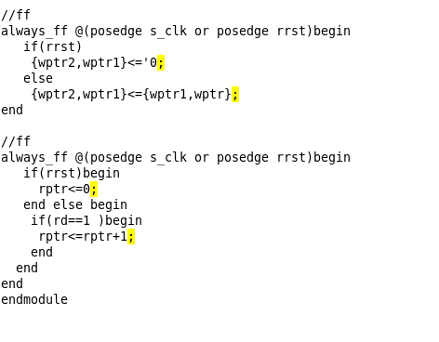
AsysC_Fifo

Slide 27
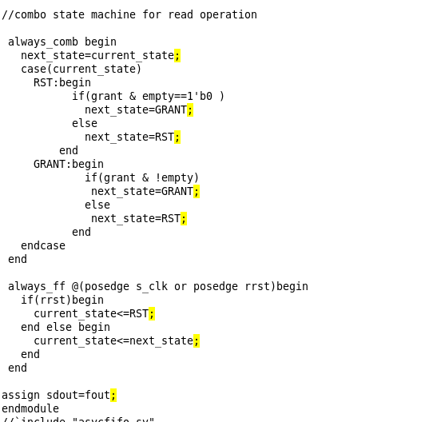
Output state machine

Slide 28
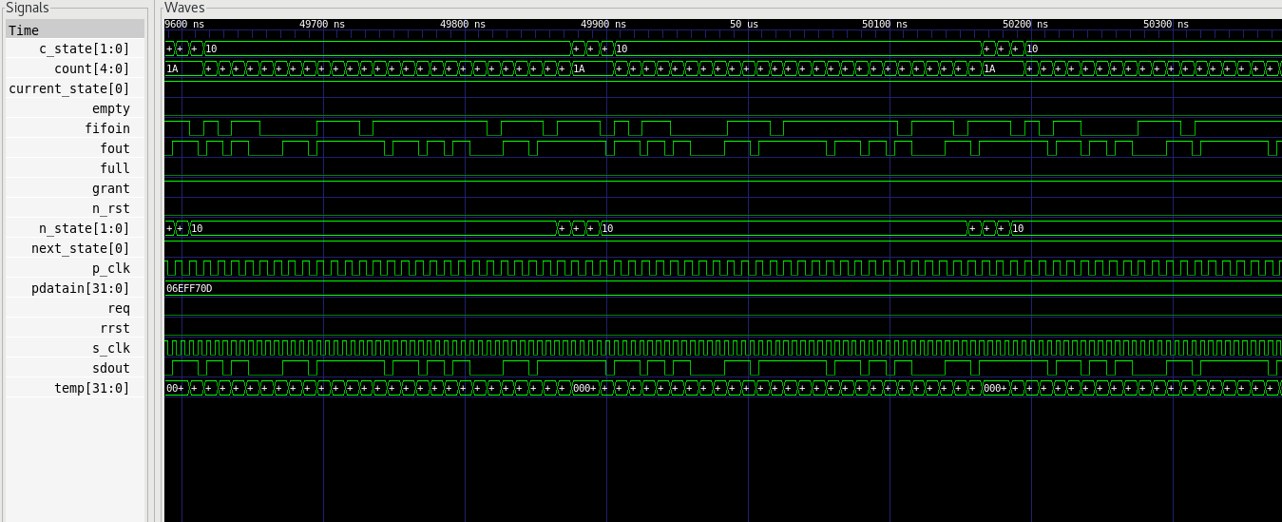
VCS Simulation results

Slide 29
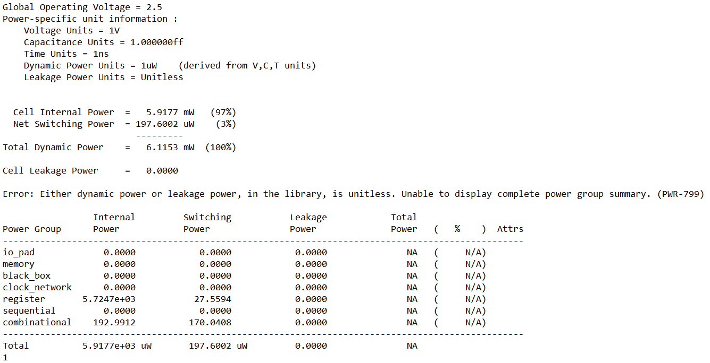
Power report

Slide 30
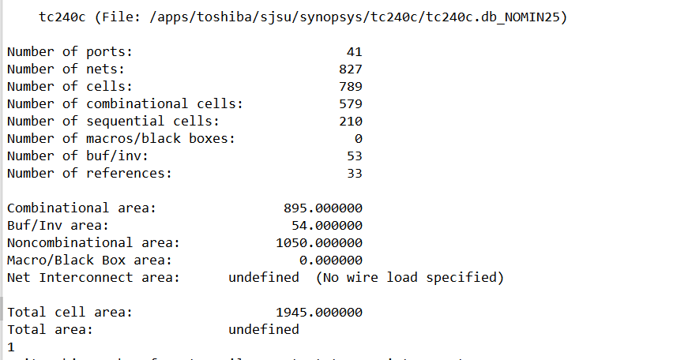
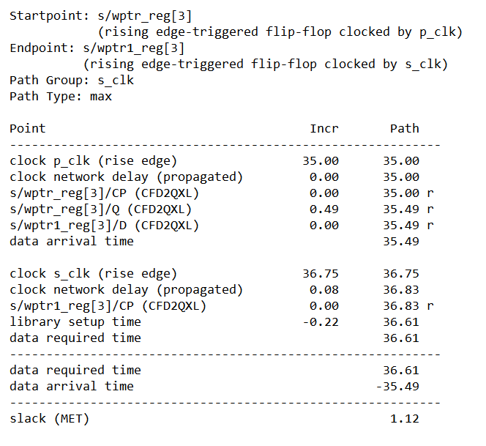
AREA AND TIMING REPORT

Slide 31
Draw back
Metastability issue can cause write pointer and read pointer FLAG false empty and full .
This can cause read_ptr to read memory location invalid data
Write pointer to overwrite valid data

Slide 32
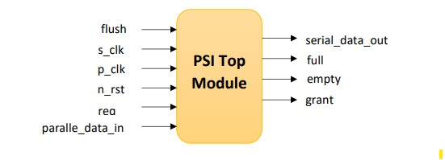
Parallel to serial interface using Asynchronous FIFO Design with Asynchronous Pointer Comparisons

Slide 33
Sections of design
Top Wrapper
FIFO design
Parallel to serial Interface
FIFO module
Output logic
Dual port memory
Asynchronous comparator
Read pointer and empty flag
Write pointer and full flag

Slide 34
Top Wrapper
The top wrapper connects all the top level design modules i.e parallel to serial interface, Fifo design and output logic.
The implementation of parallel to serial data is simple on the positive p_clk edge data is sampled and then it is given as output serially.
Push signal is used indicate valid data

Slide 35
Fifo design
Fifo memory module: FIFO has input write clk, write data,write address ,read address, write increment.
Asynchronous Comparison: In this module uses comparison logic and asserts full and empty signal.
Read pointer and empty: This module controls read pointer empty signal it is in synchronous with read clock
The assertion of empty is asynchronous and depends on write pointer.
Write pointer and full: This module controls write pointer and full flag which is mostly synchronous with read clock but full signal is asserted when read pointer increments

Slide 36
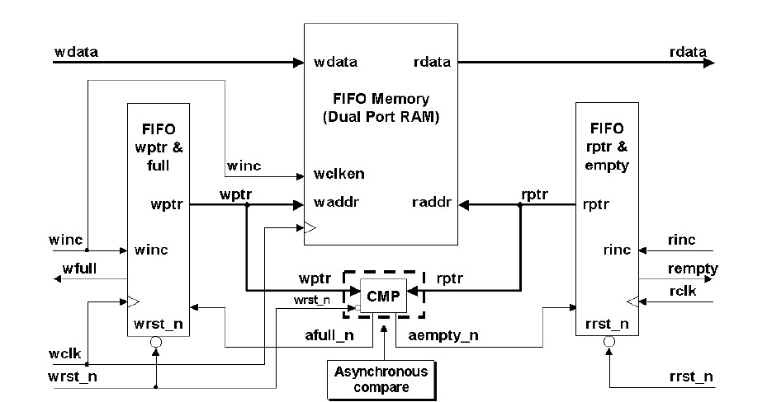

Slide 37
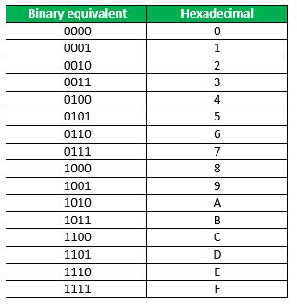
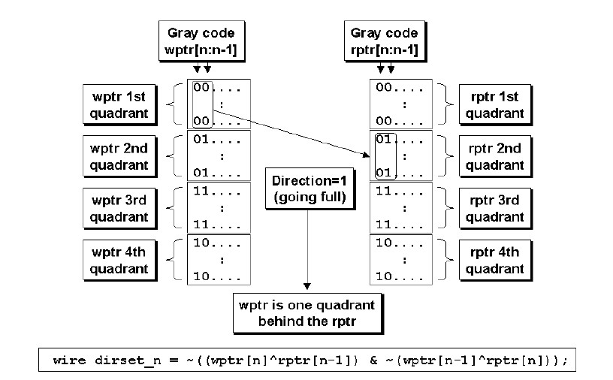
Direction set

Slide 38
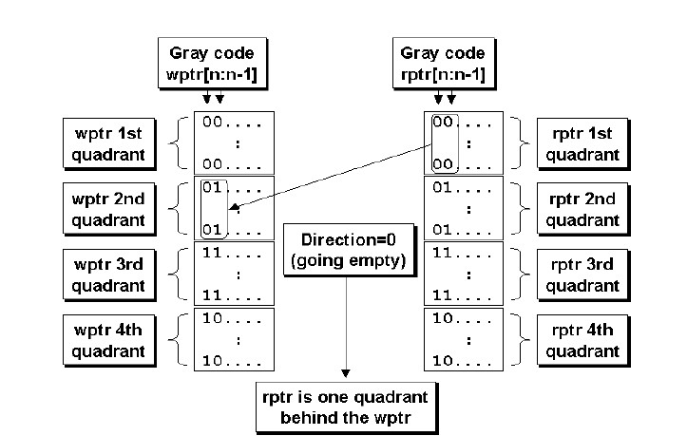
Direction clear

Slide 39
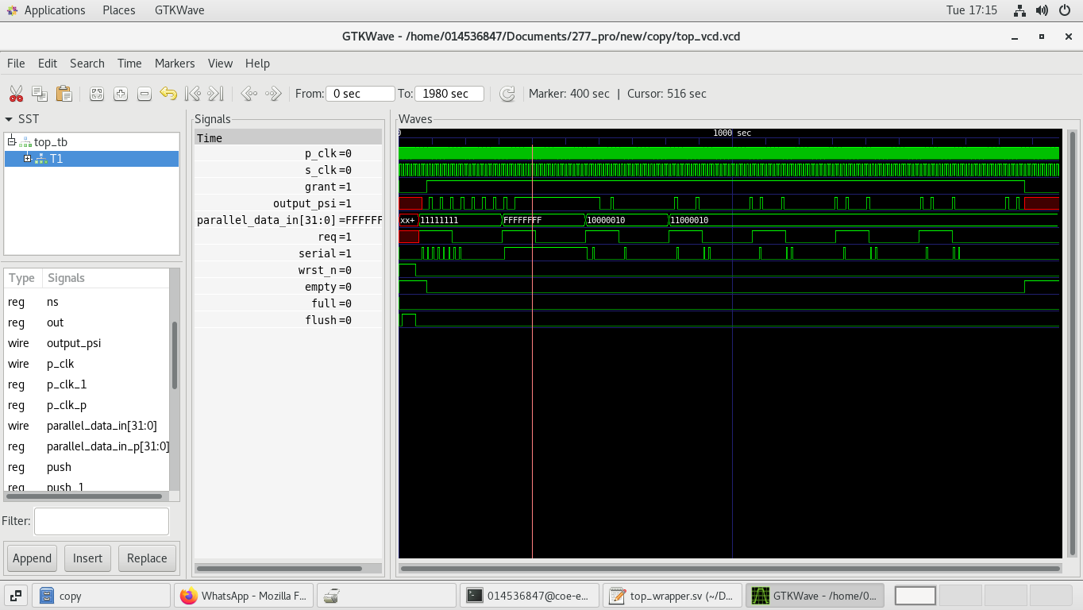
Simulation Output

Slide 40
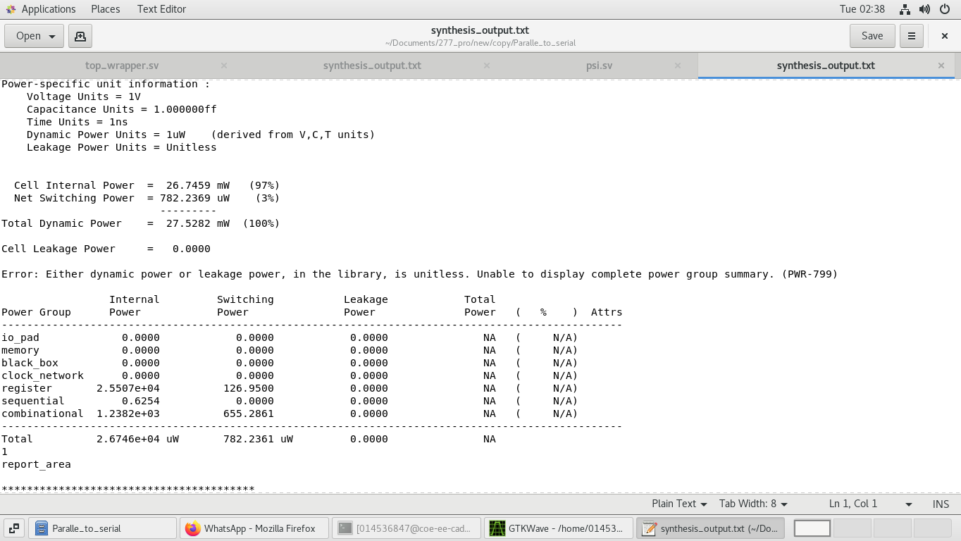
Power output

Slide 41
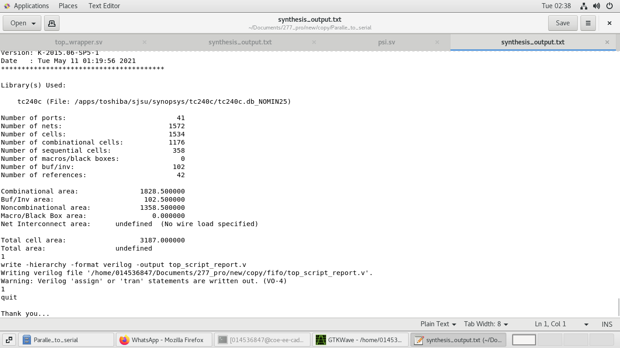
Area output

Slide 42
Advantages and drawbacks
The implementation uses more number of flip-flops while reduces the
Combinational logic which is ideal for FPGA but may not be best for ASIC.
Due to reduction in combinational logic higher frequency can be achieved.
Extra efforts are required for STA due to asynchronous components.

Slide 43
Design challenges & learning outcome:
Working with synchronizer circuit
Working with two different clock domains
Target cell library limitation during synthesis

Slide 44
Conclusion:
Synchronization of FIFO pointers is safely accomplished using three different pointers technique in the cross clock domain.

Slide 45
Reference:
C. E. Cummings, “Simulation and Synthesis Techniques for Asynchronous FIFO Design,” San Jose, CA, 2002. SNUG 2002 (Synopsys Users Group Conference, San Jose, CA, 2002) User Papers, March 2002, Section TB2, 3rd paper. Also available at www.sunburst-design.com/papers.
[E-book] Available: http://www.sunburst-design.com/papers/CummingsSNUG2002SJ_FIFO1.pdf
Clifford E. Cummings and Peter Alfke, “Simulation and Synthesis Techniques for Asynchronous FIFO Design with Asynchronous Pointer Comparisons,” SNUG 2002 (Synopsys Users Group Conference, San Jose, CA, 2002) User Papers, March 2002, Section TB2, 3rd paper. Also available at www.sunburst-design.com/papers.
[E-book] Available: http://discourse-production.oss-cn- shanghai.aliyuncs.com/original/3X/4/7/47fa3a7c83edfeea24029df12d0ae32f d9ed7610.pdf

Slide 46
Thank you

